Slide 1
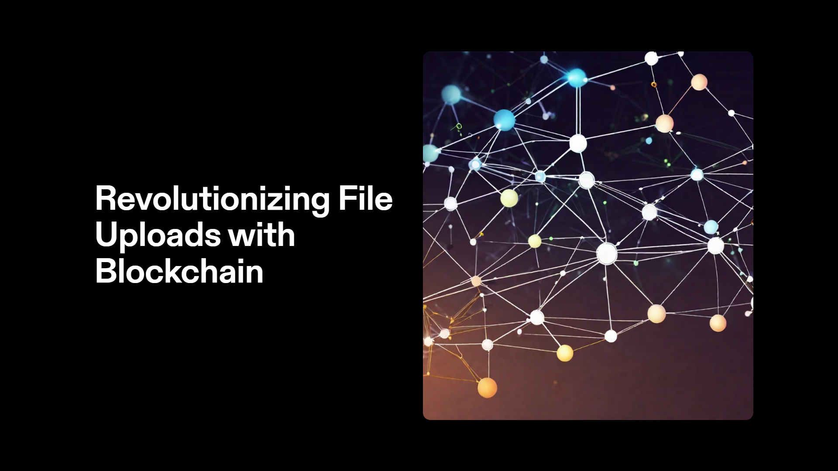
Distributed Ledger File Storage
YUVARAAJAN E

Slide 2
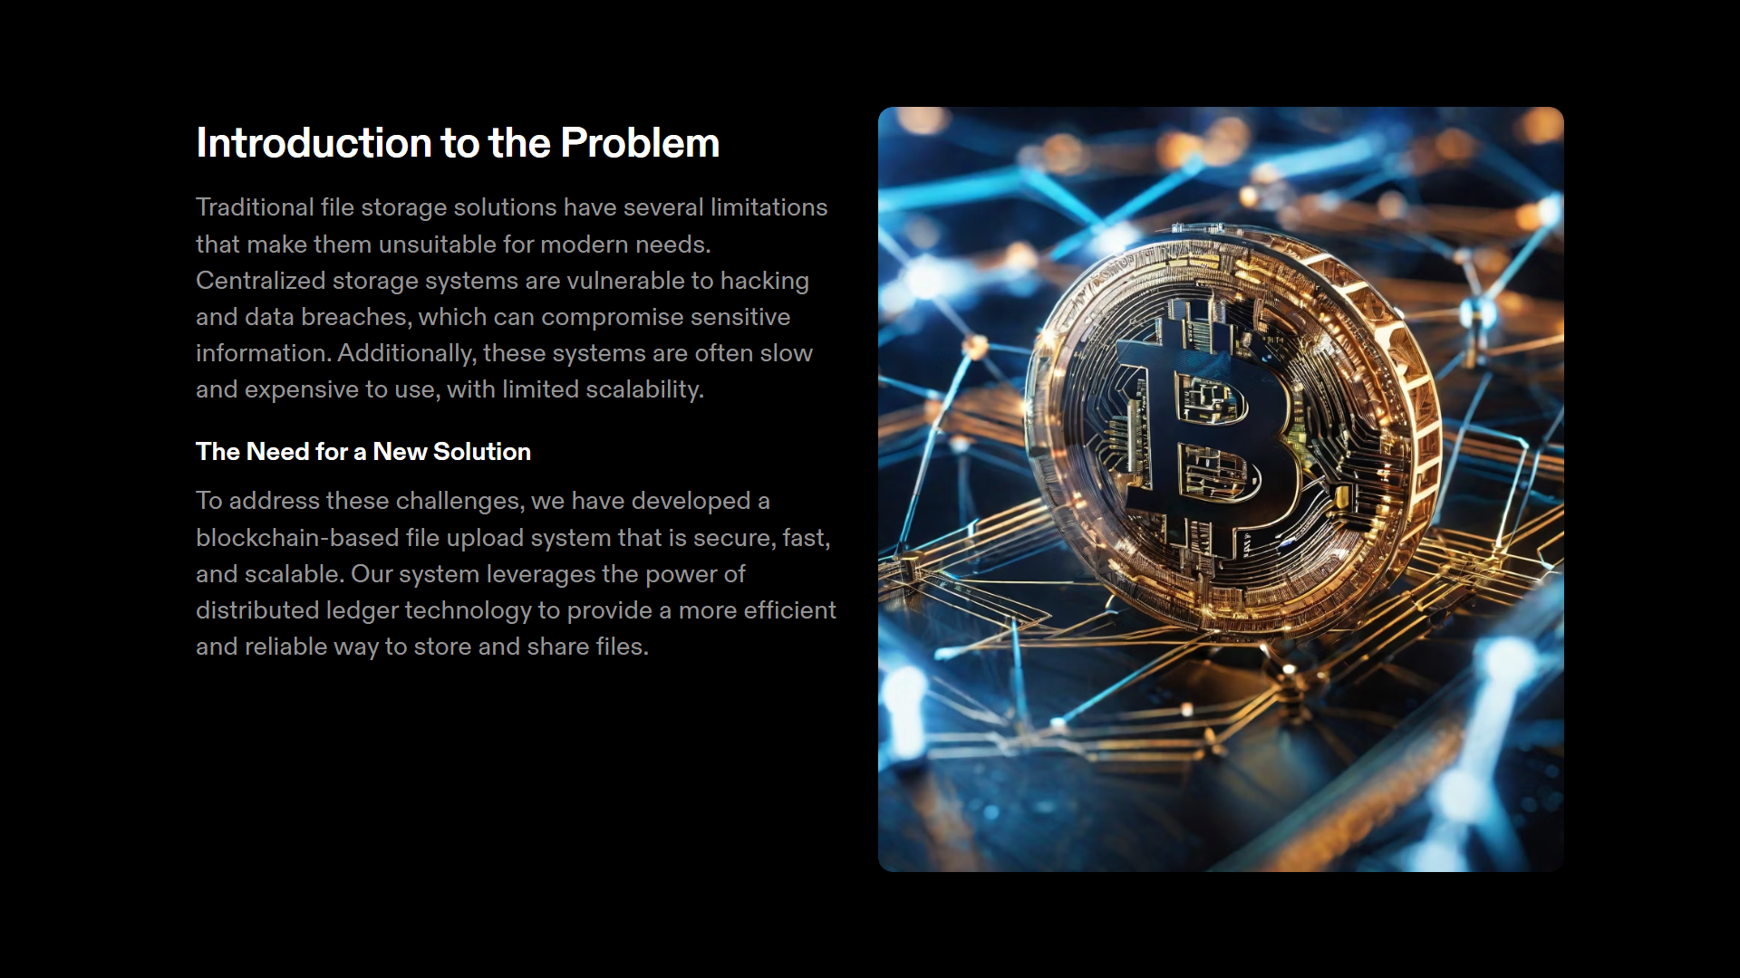

Slide 3
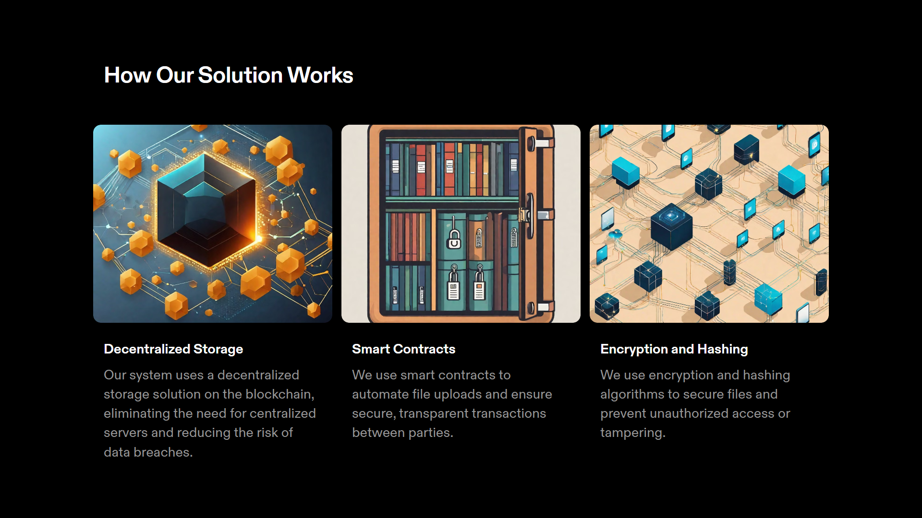

Slide 4
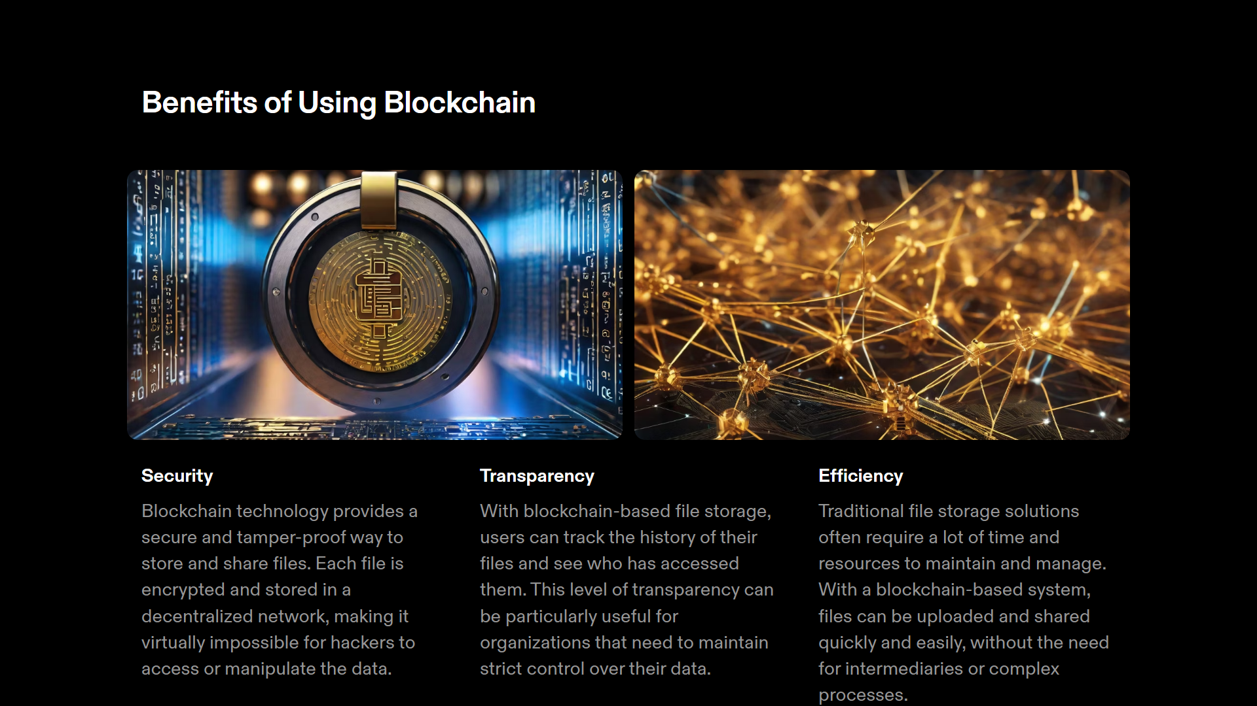

Slide 5
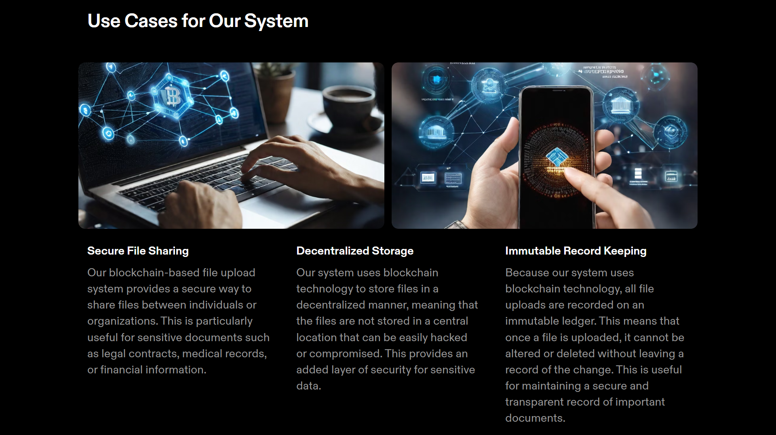

Slide 6
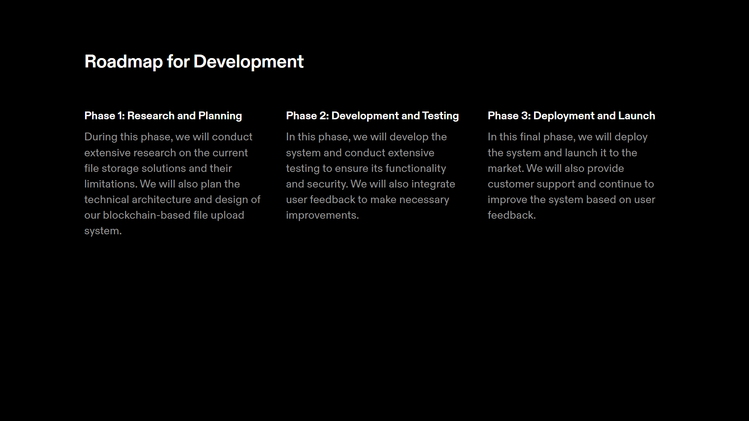

Slide 7
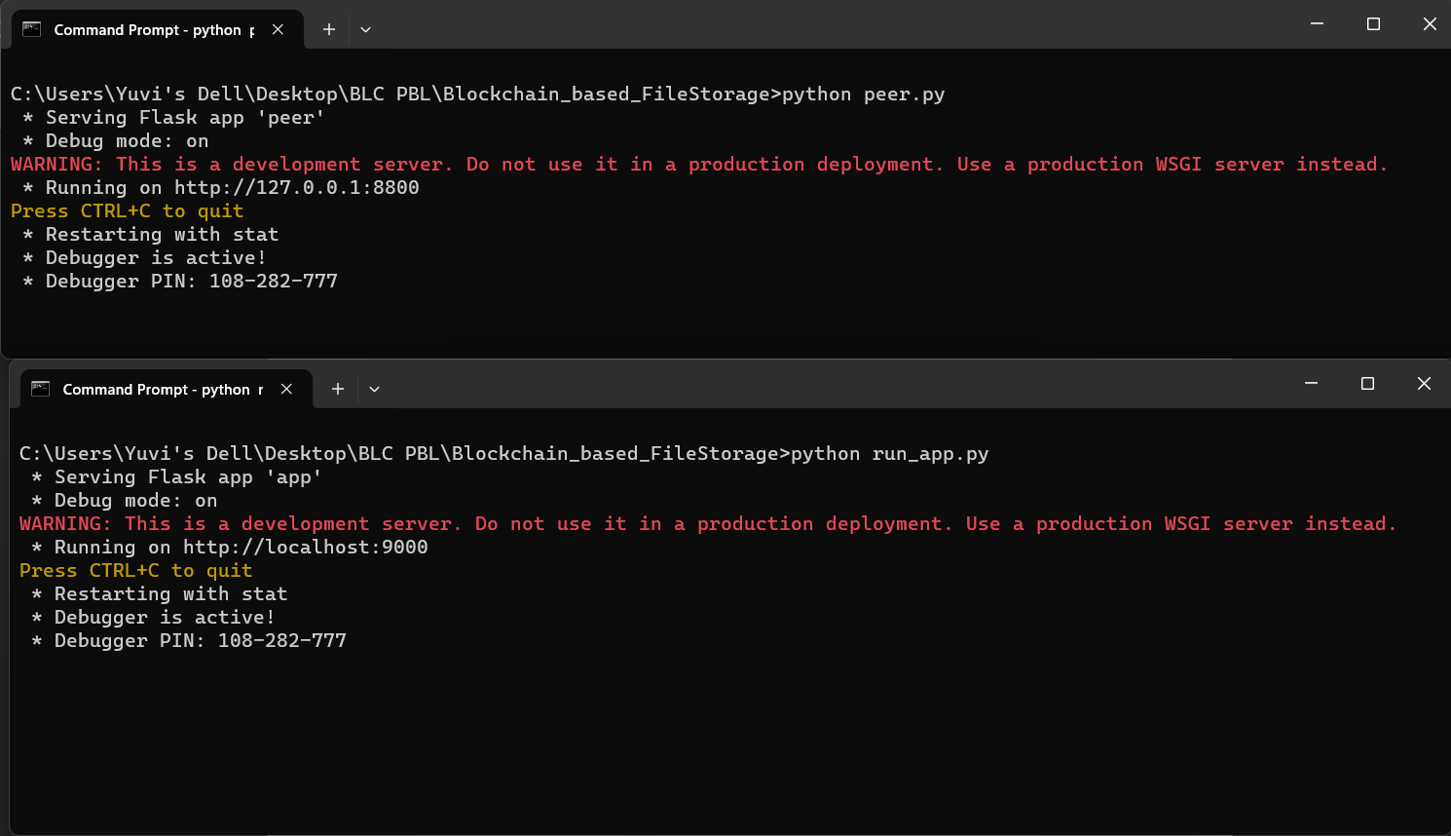
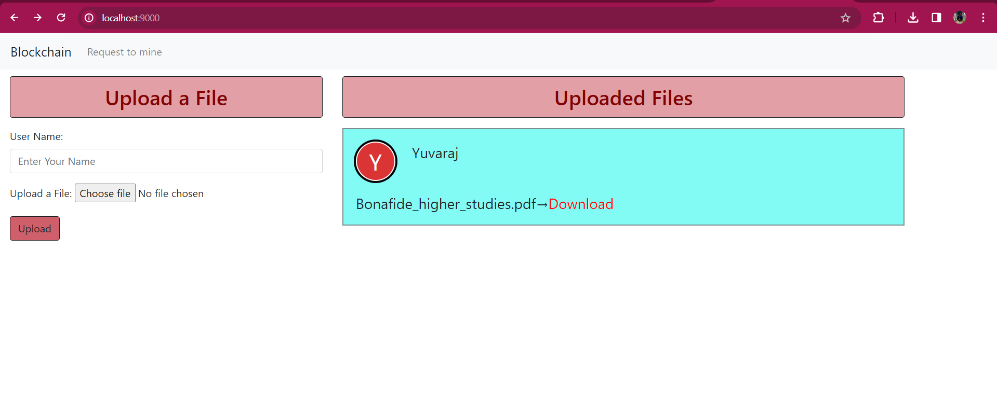
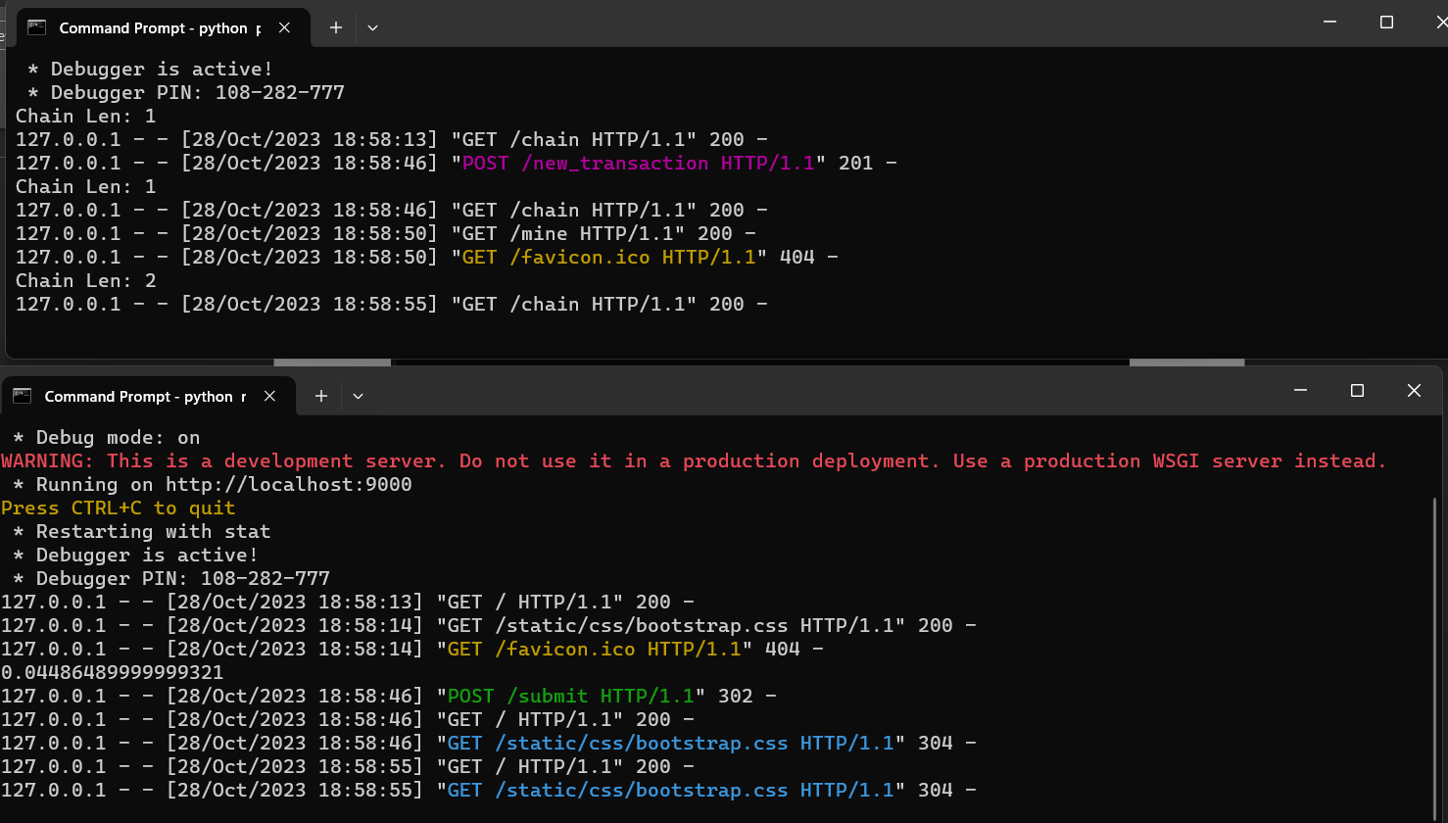
OUTPUT :

Slide 8
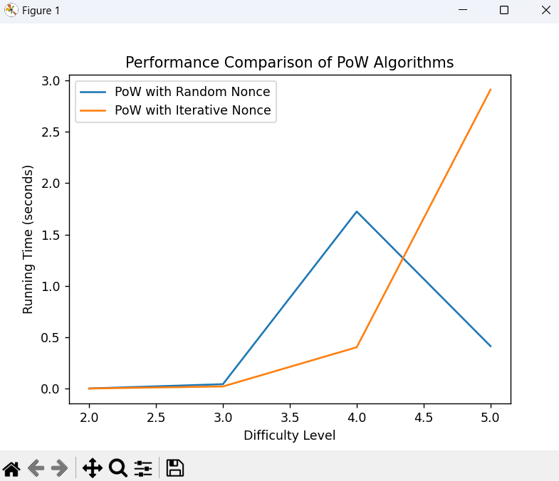
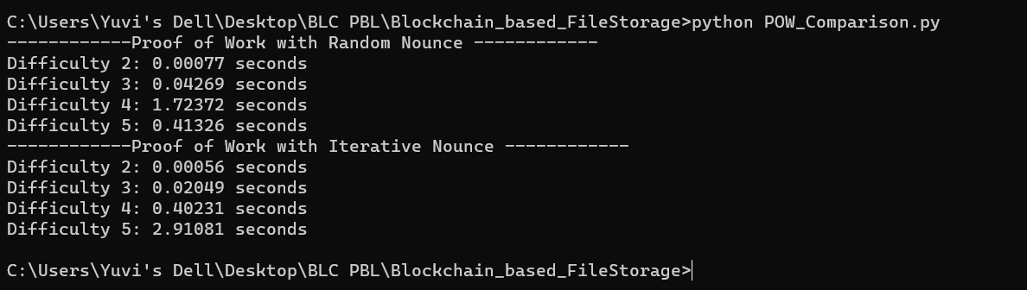
OUTPUT :

Slide 9
Related Works :
(2009). Bitcoin: A Peer-to-Peer Electronic Cash System. Cryptography Mailing list at https://metzdowd.com.
Mougayar, W. (2016). The Business Blockchain: Promise, Practice, and Application of the Next Internet Technology. Wiley.
Antonopoulos, A. M. (2014). Mastering Bitcoin: Unlocking Digital Cryptocurrencies. O'Reilly Media.
Merkle, Ralph. (1987). A Digital Signature Based on a Conventional Encryption Function. LNCS. 293. 369-378. 10.1007/3-540-48184-2_32.
Tapscott, D., & Tapscott, A. (2016). Blockchain revolution: how the technology behind bitcoin is changing money, business, and the world. Penguin.
Zohar, A. (2015). Bitcoin: under the hood. Communications of the ACM, 58(9), 104-113.
Buterin, V. (2017). Chain rule. Blog post.
Hern, A. (2017). A beginner's guide to blockchain. The Guardian.
Mikhalev, V. (2019). User interface design principles for blockchain applications. Medium.

Slide 10
Thank You !!

